Slide 1
Group Name
Haroon, Esher, Bill
RAL Visitor Centre
07.07.23

Slide 2


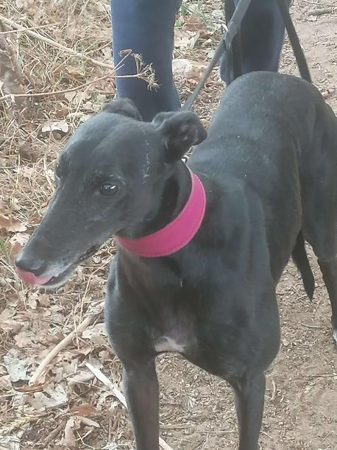
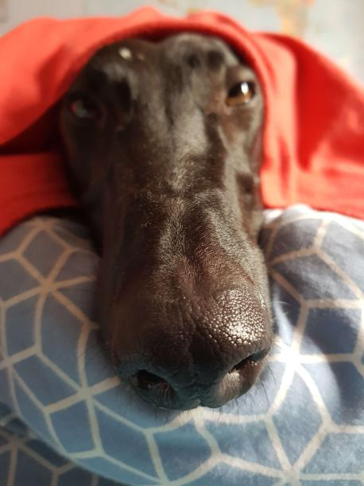
Personal Introduction & How Has This Work Experience Benefited You?
Tom Sutton:
Pets (Felina, Fernando, Joey and Baz from top left to bottom right)
Hobbies - I enjoy designing and playing games (both board and video), going to the gym, woodworking and Dungeons and Dragons.
Work Experience - Insight into the STEM life and community, still hard-set on becoming a software engineer.

Slide 3
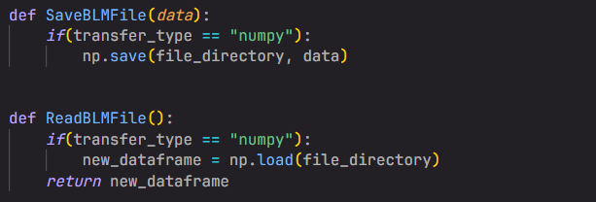
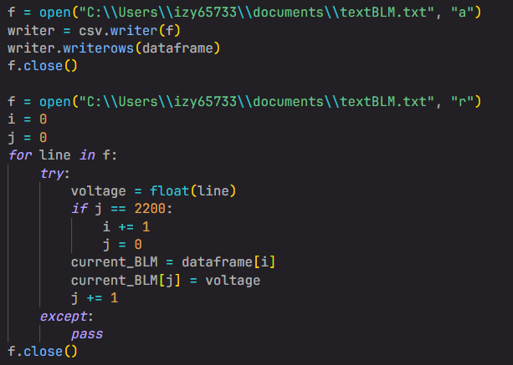
Stage 1 Projects: Group 1E: Data Handling
Aims - Finding an efficient way to store and read files, optimising transfer speeds.
Research - Different file types, different data structures, different transferring methods.
Testing - Testing speeds of transfer rates.
Results - We found that saving to numpy files lead to the fastest transfer rates

Slide 4
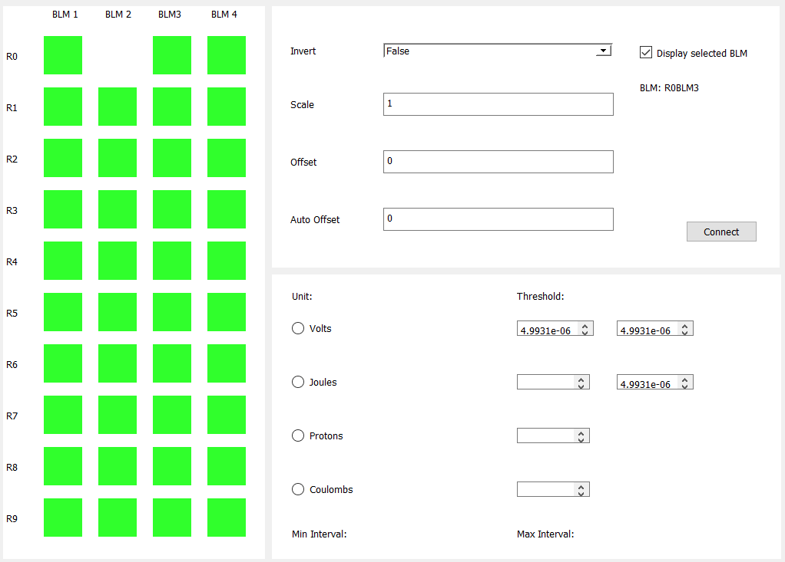
Stage 2 Projects: LED
Aims - An easy to visualise array of LEDs that display if the sum of data is less than a given threshold
Design - Design with PyQt5 designer, later with python code
Result - GUI that technically works as intended but crashes.

Slide 5
Each human should take a copy of this template, and fill in the above 3 slides
Each human should rename this template to their first name and save it
One human from each GUI group collect these templates and put them together (open 2 powerpoint instances and copy/paste the slides from the left menu), edit the title slide, acknowledgements, etc

Slide 6
Acknowledgments
We are privileged to do a job that we love, and one that serves so many. In order to do big science we require vast teams and incredible people who support our work. We must always acknowledge those who contribute to our success.
Our cleaner Pamela sanitises every desk in the building, vacuums our biscuit crumbs, mops the floors, disposes of our cups and napkins, carries our refuse to the industrial bins, ensures we have clean toilets, and often moves furniture, every day before we arrive.
Our reception team have had to phone a grumpy physicist on every occasion that you forgot your badges, and often I’ve missed their calls so they’ve sorted you out anyway. That’s a lot of unnecessary hassle for them.
Our public engagement (PE) team have read ~ 700 wx applications, sifted and sorted your applications, so that we could select you individually. All other wx students have a desk wherever their supervisor can find space. The PE team have not only granted us their space for 2 weeks, but the use of their laptops. We have exceptionally been granted use of their personal kitchen.
Please delete the above message and keep it simple:
Public Engagement Team
Etc

Slide 7
GUI Demo
5 minutes max, show live data, demo mode, change some settings and show features

Slide 8
Thank you
Questions?

